Slide 1



ATLIQ HARDWARES
CONSUMER GOODS AD HOC INSIGHTS
Presented By Karan Chadha

Slide 2
Atliq Hardwares (imaginary company) is one of the leading computer hardware producers in India and well expanded in other countries too. However, the management noticed that they do not get enough insights to make quick and smart data-informed decisions. They want to expand their data analytics team by adding several junior data analysts. Tony Sharma, their data analytics director wanted to hire someone who is good at both tech and soft skills. Hence, he decided to conduct a SQL challenge which will help him understand both the skills.
PROBLEM STATEMENT

Slide 3
Provide the list of markets in which customer "Atliq Exclusive" operates its business in the APAC region.
Request 1

Slide 4
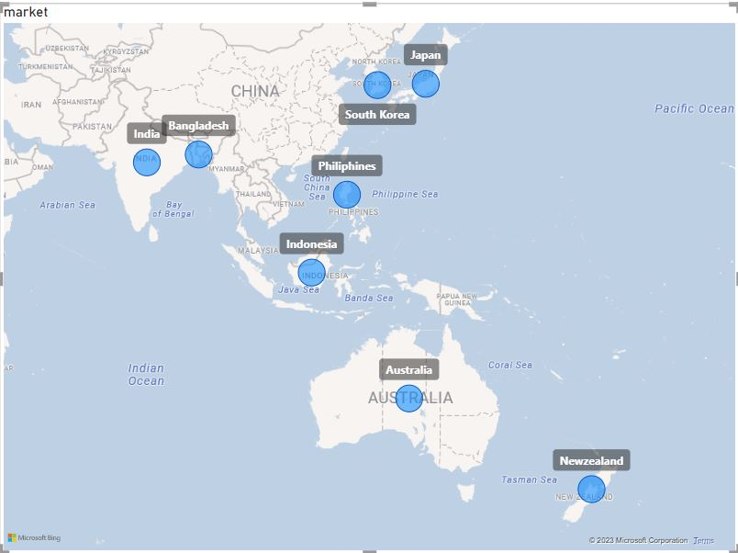
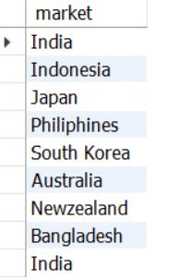
OUTPUT
Atliq hardware has customers in 27 countries belonging to 4 regions ( APAC , EU , NA , LATAM ) and here we have list of markets in which Customer ATLIQ EXCULSIVE
Operates its business belonging to APC region only.
INSIGHTS

Slide 5
What is the percentage of unique product increase in 2021 vs. 2020?
Request 2

Slide 6
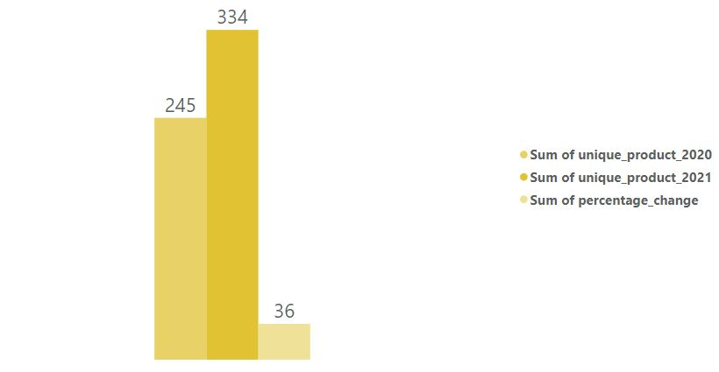

OUTPUT
INSIGHTS
In year 2020 Atliq had 245 unique peoducts while in year 2021 Atliq had 334 Unique Products which means 89 products increased in 2021 with 36.33% Growth.

Slide 7
Provide a report with all the unique product counts for each segment and sort them in descending order of product counts.
Request 3

Slide 8
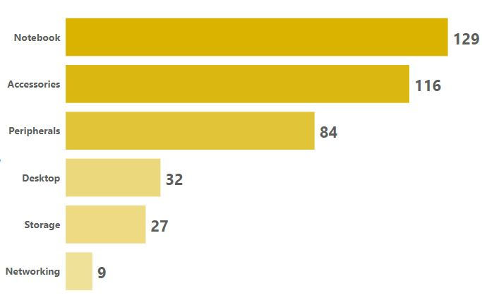
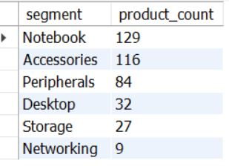
OUTPUT
Atliq hardware is operating its business in 6 Unique Segments. Out of which “Notebook” has the highest number of product count whereas “Networking” has the least number of product count .
INSIGHTS

Slide 9
Which segment had the most increase in unique products in 2021 vs 2020?
Request 4

Slide 10
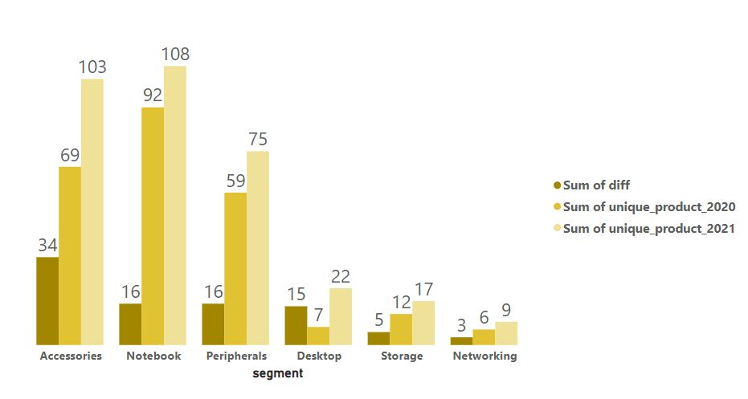
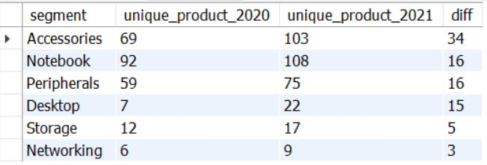
OUTPUT
Out of 6 Segments “Accessories” has the highest number of increase product counts and “Networking” has the least number of increase product counts in 2020 vs 2021
INSIGHTS

Slide 11
Get the products that have the highest and lowest manufacturing costs.
Request 5

Slide 12
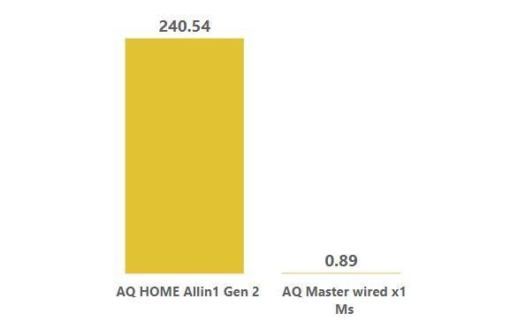

OUTPUT
Out of all the products Product Name “AQ HOME ALLIN 1 GEN 2” has the highest manufacturing cost and Product Name “AQ MASTER WIRED X1 MS” has the lowest Manufacturing cost.
INSIGHTS

Slide 13
Generate a report which contains the top 5 customers who received an average high pre_invoice_discount_pct for the fiscal year 2021 and in the Indian market.
Request 6

Slide 14
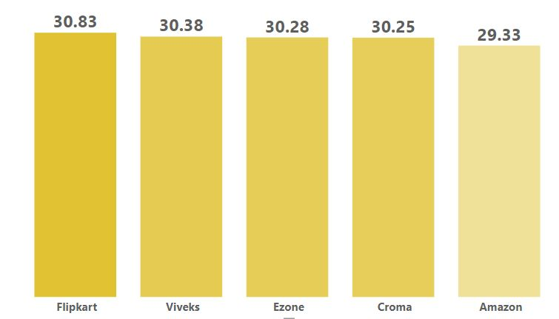
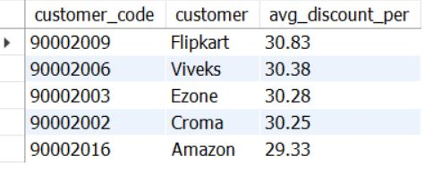
OUTPUT
In fiscal year 2021 these five customers ( Flipkart , Viveks , Ezone , Croma , Amazon ) received the highest average discount percentage in indian market.
INSIGHTS

Slide 15
Get the complete report of the Gross sales amount for the customer “Atliq Exclusive” for each month. This analysis helps to get an idea of low and high-performing months and take strategic decisions.
Request 7

Slide 16
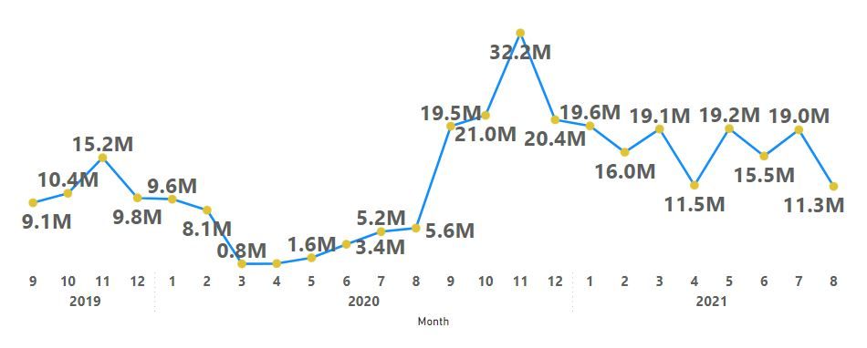
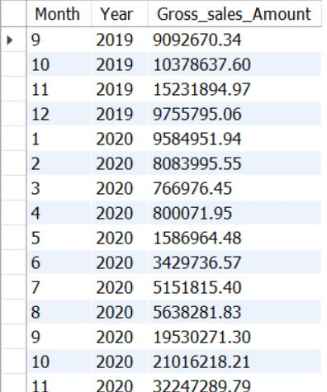
OUTPUT
For the Customer “Atliq Exclusive” in terms of gross sales amount, in November 2020 we have the highest gross sales with 32.2 million whereas in march , april , may 2020 we have very lowest gross sales as compared to 2019 and 2021.
INSIGHTS

Slide 17
In which quarter of 2020, got the maximum total_sold_quantity?
Request 8

Slide 18
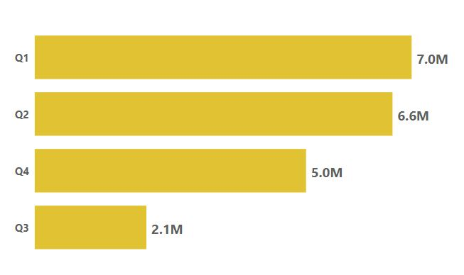
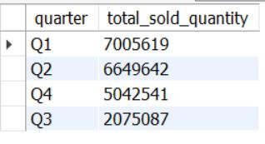
OUTPUT
In Quarter 1 of 2020 we sold the maximum products while in Quarter 3 there was decline in Sold quantity but in Quarter 4 we recovered a lot.
INSIGHTS

Slide 19
Which channel helped to bring more gross sales in the fiscal year 2021and the percentage of contribution?
Request 9

Slide 20
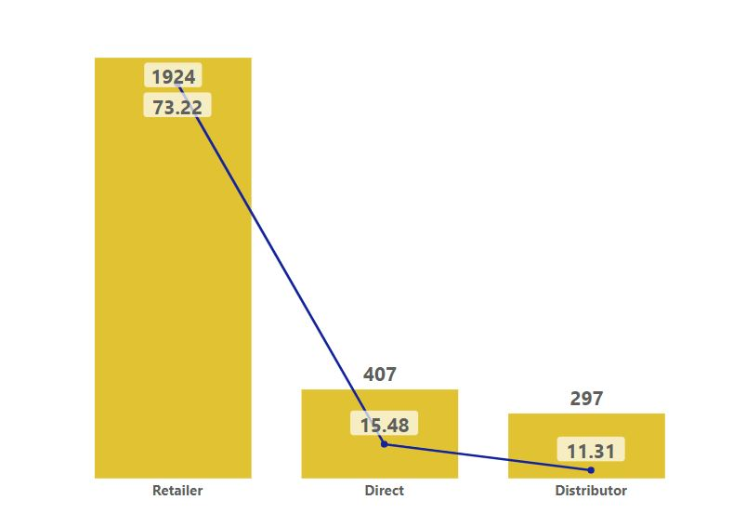
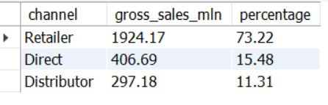
OUTPUT
Atliq Hardware has three channels from where they generate sales . Out of which “Retailer” channel helped a lot to generate the maximum sales with 73.22%.
INSIGHTS

Slide 21
Get the Top 3 products in each division that have a high total_sold_quantity in the fiscal_year 2021?
Request 10

Slide 22
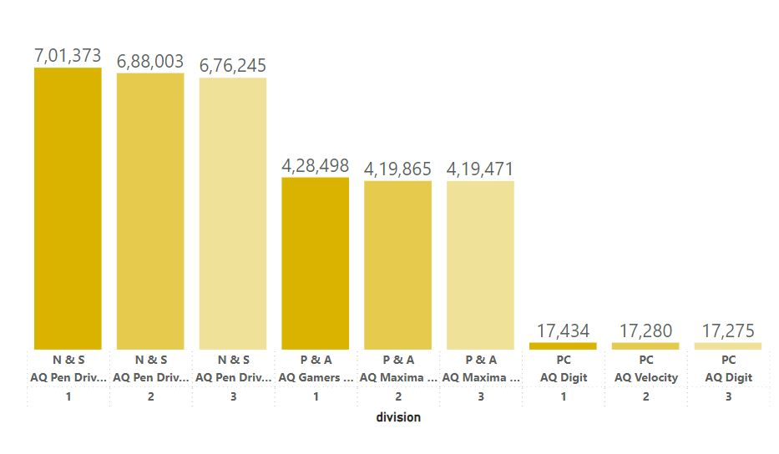
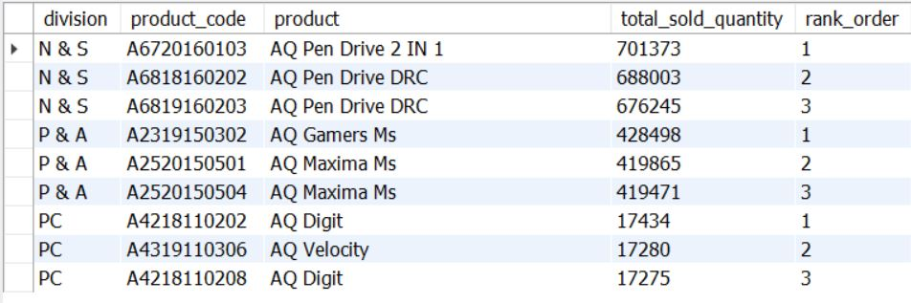
OUTPUT
These are the top 3 products in each division which received the highest sold quantity with first, second and third rank orders.
INSIGHTS

